Slide 1
CSOPESY OS
Desktop-Style OS Mockup with Dear ImGui
TECHNICAL REPORT
Karl Matthew Dela Cruz
Jose Miguel Espinosa
Bon Windel Aquino
Dencel Angelo Pineda
CSOPESY - October 2026

Slide 2
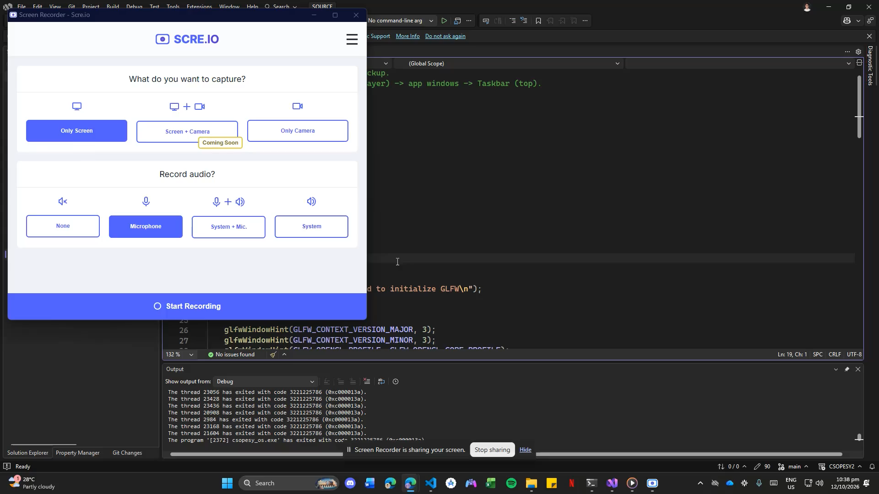

Slide 3
03
Architectural Diagram
GLFW + OpenGL Host
events, window, graphics context
OsState
boot phase
window flags
shutdown request
1 Desktop
wallpaper, clock, PWR
2 Application Windows
Files, Settings, Task Manager
3 Taskbar
fixed foreground controls
Dear ImGui Draw Data
OpenGL renderer presents the completed frame
Source: src/main.cpp and src/OsState.h

Slide 4
04
Code Snippets
src/main.cpp · compositor loop
src/Desktop.cpp · controlled shutdown
while (!state.shutdownRequested) {
glfwPollEvents();
if (glfwWindowShouldClose(window)) {
glfwSetWindowShouldClose(window, GLFW_FALSE);
}
Desktop::Render(state);
if (state.showFileExplorer)
FileExplorer::Render(state);
if (state.showSettings)
Settings::Render(state);
if (state.showTaskManager)
TaskManager::Render(state);
Taskbar::Render(state);
}
if (ImGui::Button("PWR", btnSize)) {
ImGui::OpenPopup("Shut Down?");
}
if (ImGui::Button("Shut Down",
ImVec2(120, 0))) {
state.shutdownRequested = true;
ImGui::CloseCurrentPopup();
}
The native title-bar close request is cleared in the frame loop. Only the confirmed PWR action sets shutdownRequested.

Slide 5
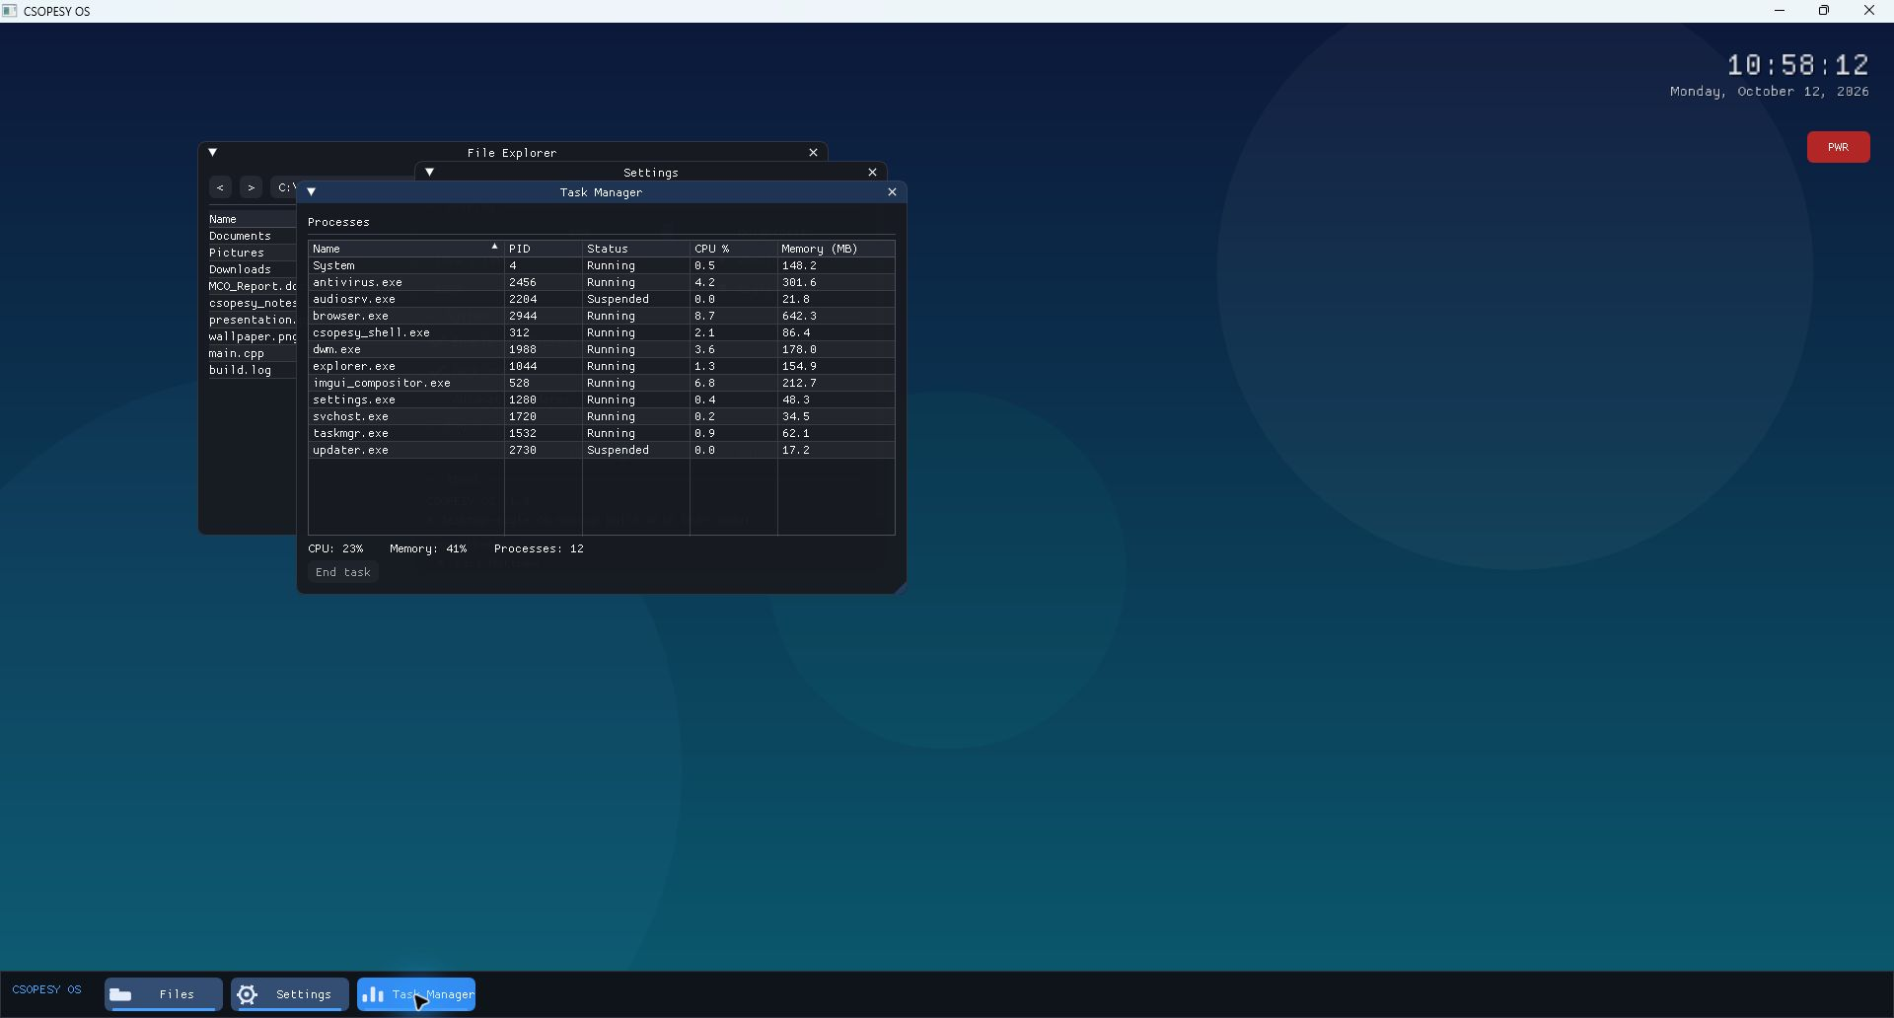
05
Written Discussion on our Desktop-Style OS Design
Design decisions
The desktop fills the viewport and draws a gradient wallpaper, soft patterns, the live clock, and PWR control every frame.
OsState stores the boot phase, open-window flags, and shutdown request so every screen reads the same state.
The taskbar toggles File Explorer, Settings, and Task Manager while active indicators show which windows are open.
Task Manager uses a sortable Dear ImGui table with dummy process, CPU, and memory values.
The compositor draws the desktop first, application windows next, and the taskbar last. A confirmed PWR action ends the loop.
Runtime composition
The screenshot shows independent ImGui windows layered over the desktop while the fixed taskbar stays in the foreground.
Runtime view captured from build/csopesy_os.exe

